Slide 1

Concepts of OOPS

Slide 2
Agenda
After this session, you will know
OOPS
Abstraction
Encapsulation
Inheritance
Polymorphism

Slide 3
OOPS - Definition
OOPS is key to understanding how Java works.
Java OOP concepts let us create working methods and variables, then re-use all or part of them without compromising security
They are:
Abstraction
Encapsulation
Inheritance
Polymorphism

Slide 4
Abstraction
Means simple things like objects, classes, and variables represent more complex underlying code and data
This is important because it lets avoid repeating the same work multiple times.

Slide 5
Abstraction
Use abstraction, if you know something needs to be in class but implementation of that varies.
In Java, you cannot create instance of abstract class, its compiler error.
abstract is a keyword in java.
A class automatically becomes abstract class when any of its method declared as abstract.
abstract method doesn't have method body.
Variable cannot be made abstract, its only behaviour or methods which would be abstract.
If a class extends an abstract class or interface it has to provide implementation to all its abstract method to be a concrete class. Alternatively this class can also be abstract.
Abstraction in java is achieved by using interface and abstract class. Interface give 100% abstraction and abstract class give 0-100% abstraction.

Slide 6
Abstract Class
A class that is declared as abstract is known as abstract class
An abstract class is something which is incomplete and you cannot create instance of abstract class.
If you want to use it you need to make it complete or concrete by extending it.
A class is called concrete if it does not contain any abstract method and implements all abstract method inherited from abstract class or interface it has implemented or extended.
Syntax: abstract class <class-name>{}

Slide 7
Abstract Method
A method that is declare as abstract and does not have implementation is known as abstract method.
If you define abstract method than class must be abstract.
An abstract method in Java doesn't have body, it’s just a declaration.
In order to use abstract method you need to override that method in Subclass.
Syntax: abstract return_type method_name ();

Slide 8
Abstraction – Example 1
abstract class Customer {
private String name;
public String getName() {
return name;
}
public void setName(String name) {
this.name = name;
}
public abstract int getPenaltyForLosingBook();
}
In the above example method getPenaltyForLosingBook do not have implementation here, whichever class inheriting will provide an implementation.
Notes:
Next slide has demo link

Slide 9
Abstraction – Example 1
class Staff extends Customer {
@Override
public int getPenaltyForLosingBook() {
return 25;
}
}
In the above example method getPenaltyForLosingBook been implemented by class Staff, its possible the same method when being implemented by a class Student extends Person, it might not have the same value.
Customer person = new Staff();
person.setName("Aegan Tangareyan");
System.out.println(person.getName());
System.out.println("Penalty for Losing Book " + person.getPenaltyForLosingBook());
Notes:
semester2\1-java8\1-coding-fundamentals-oops-control-statements\2-class-exercises-and-demos\coding-fundamentals\src\com\imarticus\tutorial\codingfundamentals\demos\oops\abstracts\AbstractionDemo.java

Slide 10

Exercise
Create an abstract class Employee
let it have properties
name
hourlyRate
Create an abstract method calculateSalary
Create a class Contractor extends Employee
Let it have property workingHours
Create a class FullTimeEmployee extends Employee
Let it have property workingHours
Use the abstract method by overriding the same method with returning the output of different salary for contractors and full time employees based on their working hours and hourlyrate daily
Notes:
semester2\1-java8\1-coding-fundamentals-oops-control-statements\2-class-exercises-and-demos\coding-fundamentals\src\com\imarticus\tutorial\codingfundamentals\exercises\oops\abstracts\AbstractionDemo.java

Slide 11
Encapsulation
The practice of keeping fields within a class private, then providing access to them via public methods.
It’s a protective barrier that keeps the data and code safe within the class itself.
We can re-use objects like code components or variables without allowing open access to the data system-wide.

Slide 12
Encapsulation
Calculate book price based on pages
We need to create a class Book with 3 properties
Name
Pages
Price
Price should not be modified directly
They have access to modify name & pages
Whenever pages has been changed, price needs to be changed

Slide 13
Encapsulation
Calculate book price based on pages
public class Book { String name;
private int pages;
private double price; public Book(String name, int pages) {
super();
this.name = name;
this.setPages(pages); } public void setPages(int pages) {
this.pages = pages;
this.price = pages * 0.24; } public int getPages() {
return pages;
} public double getPrice() {
return price;
}
}
Notes:
semester2\1-java8\1-coding-fundamentals-oops-control-statements\2-class-exercises-and-demos\coding-fundamentals\src\com\imarticus\tutorial\codingfundamentals\demos\oops\encapsulation\Book.java

Slide 14
Encapsulation
Calculate book price based on pages
Methods getPages & setPages will be used for modifying pages
By Modifying pages variables via setPages,
We can include some additional logic as changing price within it.
This process of hiding variables, but allowing access via methods is called encapsulation.
Notes:
semester2\1-java8\1-coding-fundamentals-oops-control-statements\2-class-exercises-and-demos\coding-fundamentals\src\com\imarticus\tutorial\codingfundamentals\demos\oops\encapsulation\Book.java

Slide 15
Exercise
Create a class Library with below properties
numberOfBooks
With initial value passed as constructor
Encapsulate numberOfBooks, The value should be changed only
If rentBook method is called, decrement by 1
If returnBook method is called, increment by 1
Print number of books, whenever it value changes.
Notes:
semester2\1-java8\1-coding-fundamentals-oops-control-statements\2-class-exercises-and-demos\coding-fundamentals\src\com\imarticus\tutorial\codingfundamentals\exercises\oops\encapsulation\Library.java

Slide 16
Inheritance
It lets programmers create new classes that share some of the attributes of existing classes.
This lets us build on previous work without reinventing the wheel.
We call the inheriting class a subclass or a child class.
The original class is often called the parent.
We use the keyword extends to define a new class that inherits. properties from an old class
Syntax:
class Super { ..... ..... } class Sub extends Super { ..... ..... }

Slide 17
Inheritance
Calculator
public class Calculator {
int result;
public void add(int firstNumber, int secondNumber) {
result = firstNumber + secondNumber;
System.out.println("The sum of the given numbers:"+result);
}
public void subtract(int firstNumber, int secondNumber) {
result = firstNumber - secondNumber;
System.out.println("The difference between the given numbers:"+result);
}
}
The above class Calculator has two methods add & subtract

Slide 18
Inheritance
Calculator
public class CustomCalculator extends Calculator { public void multiplication(int firstNumber, int secondNumber) {
result = firstNumber * secondNumber;
System.out.println("The product of the given numbers:"+result);
}
}
public static void main(String args[]) {
int a = 20, b = 10;
CustomCalculator calculator = new CustomCalculator();
calculator.add(a, b);
calculator.subtract(a, b);
calculator.multiplication(a, b);
} }
We will create a custom class CustomCalculator which extends Calculator class, along with addition and subtraction, it also gives multiplication, the process of extending a class is called Inheritance.
Notes:
semester2\1-java8\1-coding-fundamentals-oops-control-statements\2-class-exercises-and-demos\coding-fundamentals\src\com\imarticus\tutorial\codingfundamentals\demos\oops\inheritance\CustomCalculator.java

Slide 19
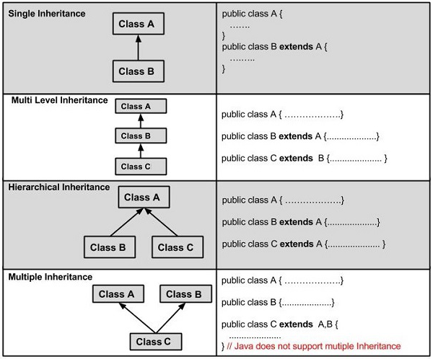
Inheritance
Inheritance
A very important fact to remember is that Java does not support multiple inheritance.
This means that a class cannot extend more than one class. Therefore following is illegal.
Example:
public class extends Animal, Mammal{}

Slide 20
Exercise
class Processor{
int numberOfProcessors =1;
} class DualCoreProcessor extends Processor{
int numberOfProcessors =2;
} public class InheritanceDemo { public static void main(String[] args) {
Processor processor = new DualCoreProcessor();
System.out.println("Number of Processors" + processor.numberOfProcessors); }
}
What will be the output of the below program ?

Slide 21
Exercise
Create a class Science with property
numberOfStudents
Create a sub class Chemistry that extends the super class Science
Create a method in Chemistry class to print the variable numberOfStudents.
Notes:
semester2\1-java8\1-coding-fundamentals-oops-control-statements\2-class-exercises-and-demos\coding-fundamentals\src\com\imarticus\tutorial\codingfundamentals\exercises\oops\inheritance\exercise2\PrintNumberOfStudents.java

Slide 22
Polymorphism
It lets programmers use the same word to mean different things in different contexts.
Works by using a reference to a parent class to affect an object in the child class.
Two more examples of polymorphism
method overriding
method overloading

Slide 23
Polymorphism
method overriding
Method overriding allows a programmer to use one method in different ways depending on whether it’s invoked by an object of the parent class or an object of the child class.
method overloading
In method overloading, a single method name might work in different ways depending on what arguments are passed to it.

Slide 24
Polymorphism
Overriding
class Customer {
String role ="default";
public void greet() {
System.out.println("Hi Customer");
}
}
class Staff extends Customer {
String role ="Staff";
public void greet() {
System.out.println("Halo Staff");
}
}
A parent class variable be created via new instance of Child class
This code print hallo staff.
The methods will be invoked based on the way instances created than how its assigned.
Customer samuelTanly = new Staff();
samuelTanly.greet();
Notes:
semester2\1-java8\1-coding-fundamentals-oops-control-statements\2-class-exercises-and-demos\coding-fundamentals\src\com\imarticus\tutorial\codingfundamentals\demos\oops\polymorphism\OverRidingDemo.java

Slide 25
Polymorphism
Overriding
Two methods carry same name but different arguments is method overloading
Here the method greet() is overloaded twice: first method has no parameters, second method has 1 string parameter
Which method is to be called is determined by the arguments we pass while calling methods.
This happens at runtime compile time so this type of polymorphism is known as compile time polymorphism.
class Student {
public void greet() {
System.out.println("Hi Student");
}
public void greet(String name) {
System.out.println("Hi “ + name);
}
}
Student jonSnow = new Student();
jonSnow.greet();
jonSnow.greet("Jon Snow");
Notes:
semester2\1-java8\1-coding-fundamentals-oops-control-statements\2-class-exercises-and-demos\coding-fundamentals\src\com\imarticus\tutorial\codingfundamentals\demos\oops\polymorphism\OverLoadingDemo.java

Slide 26
Class Modifiers
Default and Public
Final Classes
When used in a class declaration, the final keyword means the class can't be subclassed. In other words, no other class can ever extend (inherit from) a final class, and any attempts to do so will give you a compiler error.
Abstract Classes
An abstract class can never be instantiated. Its sole purpose, mission in life, is to be extended (subclassed).

Slide 27
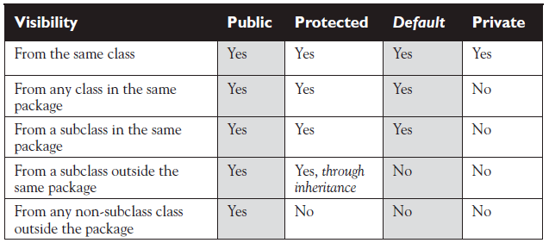
Class Modifiers
Access to Class Members

Slide 28
Access Modifiers
Because method and variable members are usually given access control in exactly the same way, we'll cover both in this section.
Whereas a class can use just two of the four access control levels (default or public), members can use all four:
public
protected
default
private

Slide 29
Final Methods
The final keyword prevents a method from being overridden in a subclass, and is often used to enforce the API functionality of a method.
In the below sample, method showSample cannot be overridden.
class SuperClass{
public final void showSample() {
System.out.println("One thing.");
}
}

Slide 30
Static Methods & Variables
The static keyword before a method, make the method accessible to be class level
The static keyword before a variable, make the variable accessible to be class level

Slide 31
Static Methods & Variables
Cash available in Bank
class BankAccount { //private static cannot be accessed outside class
private static double cashInBank = 10000; public void deposit(double amount) { cashInBank += amount;
System.out.println("deposited " + amount);
} public void withdraw(double amount) { //static variables can be accessed within instance methods
cashInBank -= amount;
System.out.println("WithDrawn " + amount);
} public static void printCashInBank() {
System.out.println("Cash in Bank" + cashInBank);
} }
Notes:
Applicable for next slide as well
content-creation\semester2\1-java8\1-coding-fundamentals-oops-control-statements\2-class-exercises-and-demos\coding-fundamentals\src\com\imarticus\tutorial\codingfundamentals\demos\oops\staticelements\StaticDemo.java

Slide 32
Static Methods & Variables
Cash available in Bank –continued…
//public static methods can be accessed by classname.methodname
BankAccount.printCashInBank();
BankAccount euron = new BankAccount();
euron.deposit(900);
BankAccount.printCashInBank();
BankAccount cersei = new BankAccount();
cersei.withdraw(5000);
BankAccount.printCashInBank();
Notes:
content-creation\semester2\1-java8\1-coding-fundamentals-oops-control-statements\2-class-exercises-and-demos\coding-fundamentals\src\com\imarticus\tutorial\codingfundamentals\demos\oops\staticelements\StaticDemo.java

Slide 33
Final Static Variable
Java does not have constants.
Use final static variables to denote constants
All final static variables should be UPPERCASE characters splitted by Underscores.
public static final String API_ENDPOINT_URL ="https://www.weather.gov/getData";

Slide 34

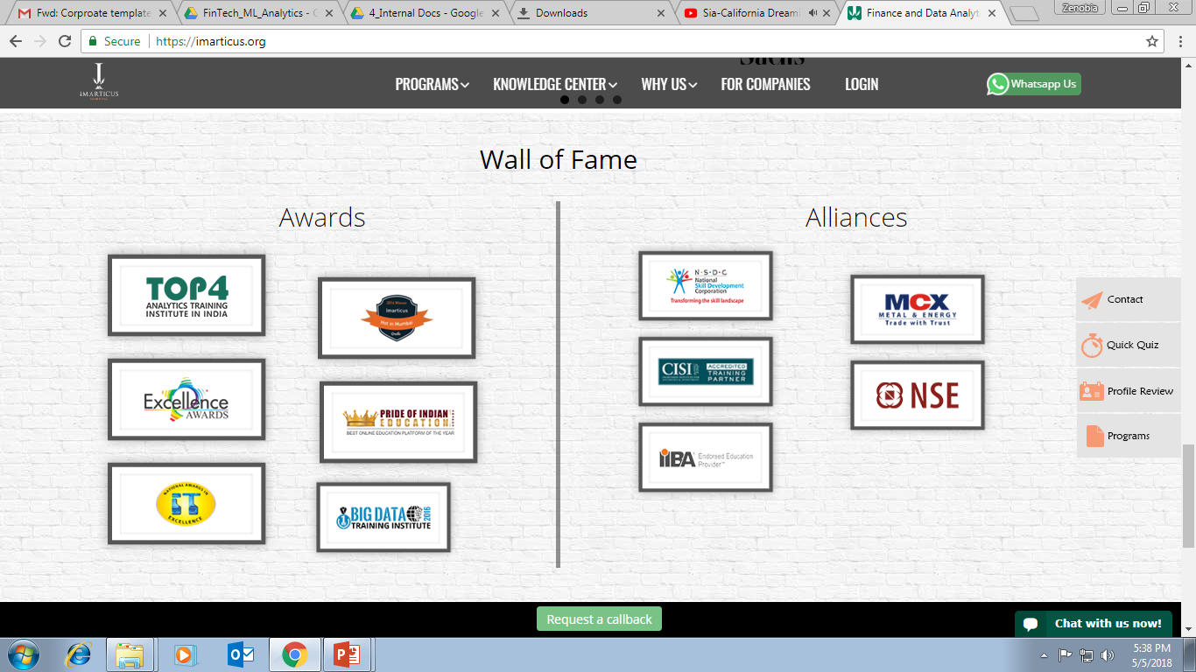



AWARDS:
Learn more:
https://imarticus.org/corporate/
Email us:
info@imarticus.com
Connect with us:
www.linkedin.com/company/imarticuslearning
ACCREDITED TRAINING PARTNER:
Watch us:
www.youtube.com/ImarticusLearninginstitute
Visit us:
Mumbai | Thane | Pune | Bangalore | Delhi - NCR | Hyderabad | Chennai | Coimbatore

